Slide 1
Operating Systems (CPU Scheduling)
Presented By Sudeshna Kundu (Mondal)

Slide 2
CPU Scheduler
Selects from the processes present in main memory that are ready to execute, and allocates the CPU to one of them
CPU scheduling decisions may take place when a process:
1. Switches from running to waiting/blocked state
2. Switches from running to ready state
3. Terminates (Zombie)

Slide 3
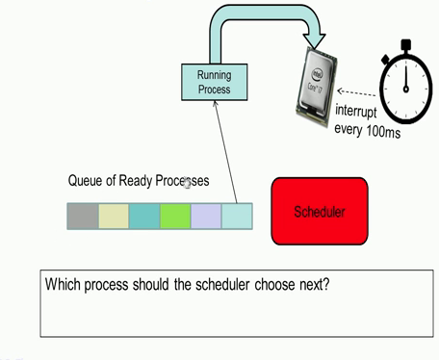
Which Process to choose?

Slide 4
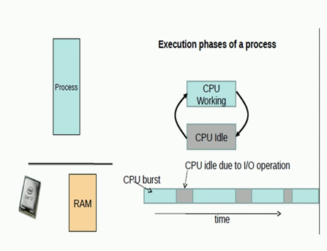
CPU Burst and IO Burst
When process is actually executing instructions it is known as a CPU burst
When process is blocked on an I/O not doing any operations, the CPU is idle, it is known as IO Burst

Slide 5
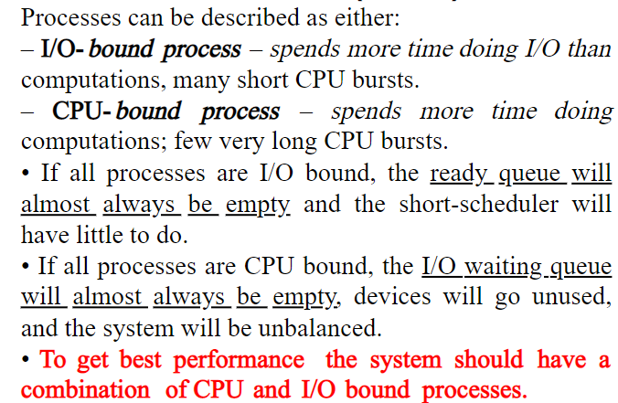
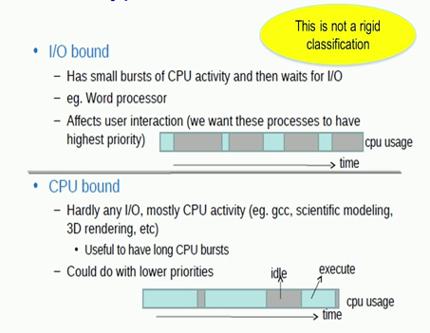
CPU bound and I/O bound process

Slide 6
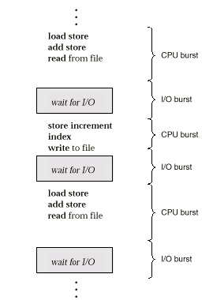
Alternating Sequence of CPU And I/O Bursts
A process which behaves both like an I/O bound as well as CPU bound, you could take for instance Microsoft excel. When we are actually entering data into the various cells in excel, it acts as I/O bound process. So, it behaves like an I/O bound process with small CPU burst and large times of I/O cycles.
While on the other hand when you are actually computing some statistic on the data entered, Excel will behave like a CPU bound process, where there is a large portion of CPU activity or the time taken to actually operate on that particular data.

Slide 7
Alternating Sequence of CPU And I/O Bursts
CPU bound processes could work with a lower priority
CPU bound applications like ‘gcc’ that is compiling a large program which takes 5 minutes. Now it will not effect this user much if the time taken to compile that particular program increases from 5 minutes to say 5.5 minutes.
I/O bound process such as the word processor higher priority with which it will get the CPU, so that the user interaction with the CPU becomes more comfortable

Slide 8
Scheduling Criteria
CPU utilization – keep the CPU as busy as possible
Throughput – # of processes that complete their execution per time unit
Turnaround time – amount of time to execute a particular process
Waiting time – amount of time a process has been waiting in the ready queue
Response time – amount of time it takes from when a request was submitted until the first response is produced, not output (for time-sharing environment)

Slide 9
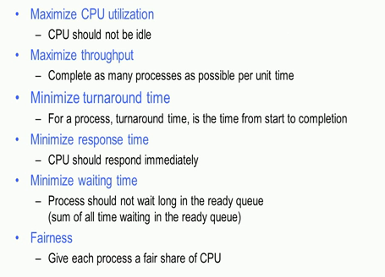
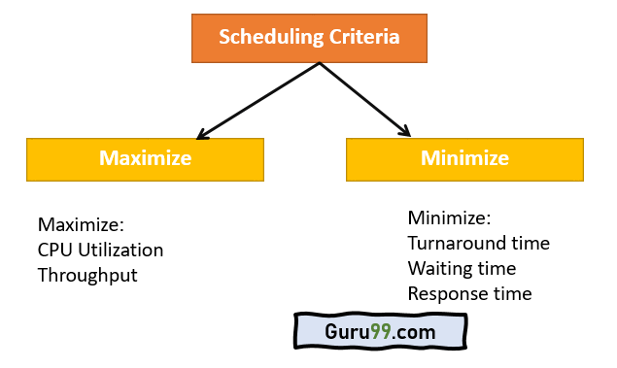
Optimization Criteria

Slide 10
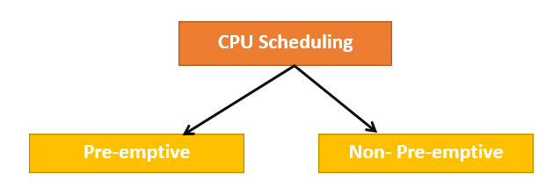
Types of CPU Scheduling
Here are two kinds of Scheduling methods:
Preemptive Scheduling
In Preemptive Scheduling, the tasks are mostly assigned with their priorities. Sometimes it is important to run a task with a higher priority before another lower priority task, even if the lower priority task is still running. The lower priority task holds for some time and resumes when the higher priority task finishes its execution.
2. Non-Preemptive Scheduling
In this type of scheduling method, the CPU has been allocated to a specific process. The process that keeps the CPU busy will release the CPU either by switching context or terminating. It is the only method that can be used for various hardware platforms. That’s because it doesn’t need special hardware (for example, a timer) like preemptive scheduling.

Slide 11
Scheduling Algorithms
CPU scheduling deals with the problem of choosing a process from the ready queue to be executed by the CPU.
The following CPU scheduling algorithms will be described:
First-Come, First-Served (FCFS).
Shortest-Job-First (SJF).
Priority.
Round-Robin (RR).
Multilevel Queue.
Multilevel Feedback Queue.

Slide 12
Formula for Non-preemptive scheduling
startTime = Time at which the process started executing
completionTime (CT)= Time at which the process finished executing
Burst time (BT): The time required by a process for its execution is called as burst time.
arrivalTime(AT): Time at which the process enters Ready queue
WaitingTime(WT) = Waiting time for a process is the time duration which is spent in waiting queue by that process. (TAT – BT)
TurnaroundTime(TAT) = The time difference between completion time and arrival time is called as turnaround time. (CT - AT)
Response Time(RT)= The first scheduled time for a process is called response time. firstResponse - arrival Time (AT)

Slide 13
First-Come, First-Served (FCFS) Scheduling
First come first serve (FCFS) scheduling algorithm simply schedules the jobs according to their arrival time.
The job which comes first in the ready queue will get the CPU first. The lesser the arrival time of the job, the sooner will the job get the CPU.
FCFS scheduling may cause the problem of starvation if the burst time of the first process is the longest among all the
Completion
3
2
1
CPU
Ready Queue

Slide 14
First-Come, First-Served (FCFS) Scheduling
Example: Process Burst Time (milliseconds)
P₁ 24
P₂ 3
P₃ 3
Suppose that the processes arrive in the order: P₁ , P₂ , P₃ The Gantt Chart for the schedule is:
Waiting time for P₁ = 0; P₂ = 24; P₃ = 27
Average waiting time: (0 + 24 + 27) / 3 = 17 (milliseconds)
P₁
P₂
P₃
0
24
27
30

Slide 15
FCFS Scheduling (Cont.)
Suppose that the processes arrive in the order
P₂ , P₃ , P₁ .
The Gantt chart for the schedule is:
Waiting time for P₁ = 6; P₂ = 0; P₃ = 3
Average waiting time: (6 + 0 + 3) / 3 = 3 (milliseconds)
Much better than previous case.
The order of processes in FCFS queue is important.
P₂
P₃
P₁
0
3
6
30

Slide 16
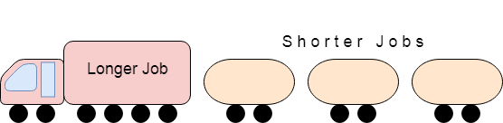
Convoy Effect in FCFS
FCFS may suffer from the convoy effect if the burst time of the first job is the highest among all. As in the real life, if a convoy is passing through the road then the other persons may get blocked until it passes completely. This can be simulated in the Operating System also.
If the CPU gets the processes of the higher burst time at the front end of the ready queue then the processes of lower burst time may get blocked which means they may never get the CPU if the job in the execution has a very high burst time. This is called convoy effect.

Slide 17
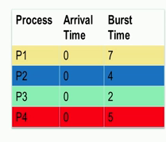
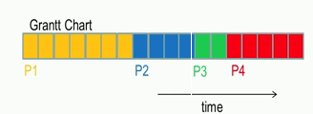
FCFS Example
Average waiting time: (0+7+11+13)/4= 7.75
Average response time: (0+7+11+13)/4= 7.75

Slide 18
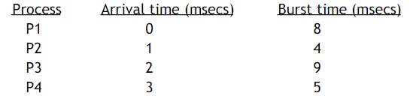
FCFS problem
Given below are the arrival and burst times of four processes P1, P2, P3 and P4. Draw the Gantt Chart using FCFS. Calculate the average waiting time, average turn around time and average response time.

Slide 19
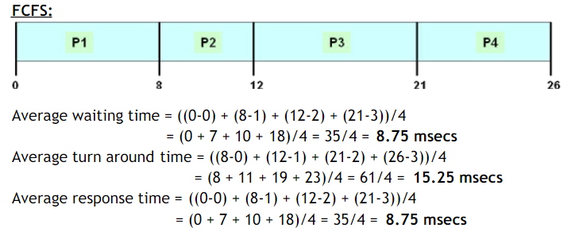
Solution

Slide 20
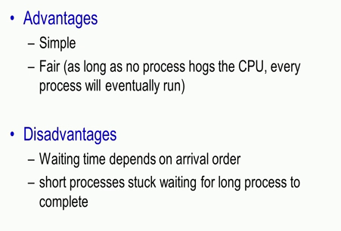
FCFS pros and Cons

Slide 21
Shortest-Job-First (SJF) Scheduling
Associate with each process the length of its next CPU burst. Use these lengths to schedule the process with the shortest time.
Two schemes:
Nonpreemptive – once CPU given to the process it cannot be preempted until completes its CPU burst.
Preemptive – if a new process arrives with CPU burst length less than remaining time of current executing process, preempt. This scheme is known as the Shortest-Remaining-Time-First (SRTF).
If two processes have the same length next CPU burst, FCFS scheduling is used.
SJF is optimal – gives minimum average waiting time for a given set of processes.

Slide 22
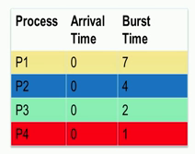
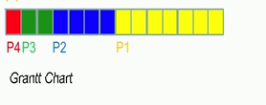
Example of Non-Preemptive SJF
Average waiting time: (7+3+1+0)/4= 2.75
Average response time: (7+3+1+0)/4 = 2.75
Average turn around time:
(14+7+3+1)/4=6.25

Slide 23
Example of Non-Preemptive SJF
Example: Process Arrival Time Burst Time
P₁ 0.0 7
P₂ 2.0 4
P₃ 4.0 1
P₄ 5.0 4
SJF (non-preemptive)
Average waiting time = ((0-0) )+(8-2)+(7-4)+(12-5))/4 = 4
Average turnaround time= ((7-0)+(12-2)+(8-4)+(16-5))/4
Average response time=((0-0)+(8-2)+(7-4)+(12-5))/4
P₁
P₃
P₂
P₄
0
3
7
8
12
16

Slide 24
Example of Non-Preemptive SJF (Cont.)
If we used FCFS, then the average waiting time would be:
(0 + 5 + 7 + 7) / 4 = 4.75
The SJF gives less average waiting time than FCFS.
The SJF is a nonpreemptive in which the waiting process with the smallest estimated run-time-to-completion is run next. Therefore, SJF is not useful in timesharing environments.
Both FCFS and SJF are not useful for timesharing environments, because they are nonpreemptive.

Slide 25
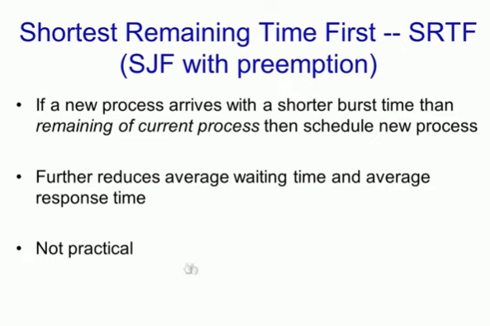

Slide 26
Example of Preemptive SJF
Example: Process Arrival Time Burst Time
P₁ 0.0 7
P₂ 2.0 4
P₃ 4.0 1
P₄ 5.0 4
SJF (preemptive) [Shortest-Remaining-Time-First (SRTF)]
Average waiting time = (11-2-0) + (5 -2-2) +(4-0-4) +(7-0-5)/4 = 3
Average turnaround time= ((16 – 0)+ (7-2)+(5-4)+(11-5))/4
Average response time= (0+(2-2)+(4-4)+(7-5))/4
P₁
P₂
P₃
P₂
P₄
P₁
0
2
4
5
7
11
16

Slide 27
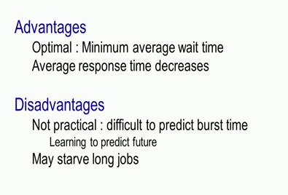
Advantage and Disadvantage SJF

Slide 28
Problem
Given below are the arrival and burst times of four processes P1, P2, P3 and P4. Draw the Gantt Chart using SJF, SRTF. Calculate the average waiting time, average turn around time and average response time.

Slide 29
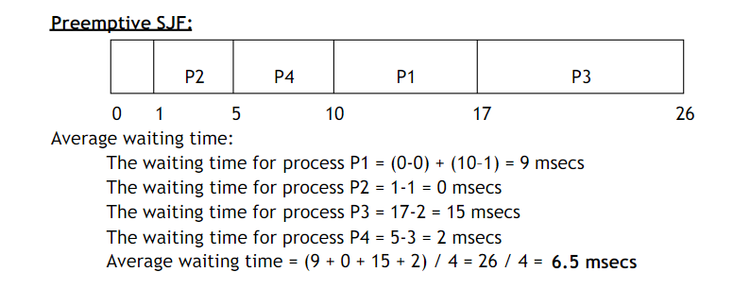
Solution (SRTF)

Slide 30
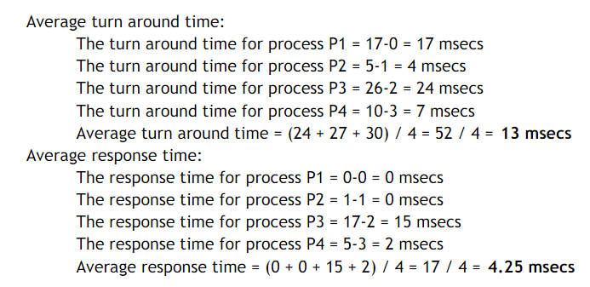
Solution(SRTF)

Slide 31
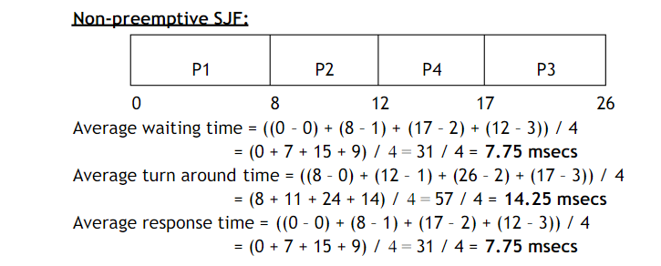
Solution( Non-preemptive SJF)

Slide 32
Priority Scheduling
A priority number (integer) is associated with each process
The CPU is allocated to the process with the highest priority (smallest integer ≡ highest priority).
Preemptive
Non-preemptive
SJF is a priority scheduling where priority is the predicted next CPU burst time.
Problem ≡ Starvation – low priority processes may never execute.
Solution ≡ Aging – as time progresses increase the priority of the process. Priorities of jobs increase the longer they wait.

Slide 33

Example of Priority Scheduling (Preemptive)
Process Arrival Time Burst Time Priority
P₁ 0 5 2
P₂ 2 4 1
P₃ 3 7 3
P₄ 5 6 4
The Gantt chart is:
Average waiting time = (4 + 0 + 6 +11)/4 = 5.25

Slide 34
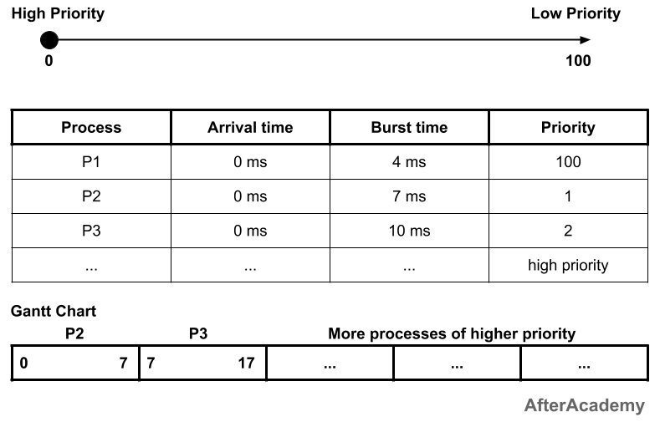
Starvation
In the above example, the process P2 is having the highest priority and the process P1 is having the lowest priority. In general, we have a number of processes that are in the ready state for its execution. So, as time passes, if only that processes are coming in the CPU that are having a higher priority than the process P1, then the process P1 will keep on waiting for its turn for CPU allocation and it will never get CPU because all the other processes are having higher priority than P1. This is called Starvation.
Starvation is a phenomenon in which a process that is present in the ready state and has low priority, keeps on waiting for the CPU allocation because some other process with higher priority comes with due respect to time.

Slide 35
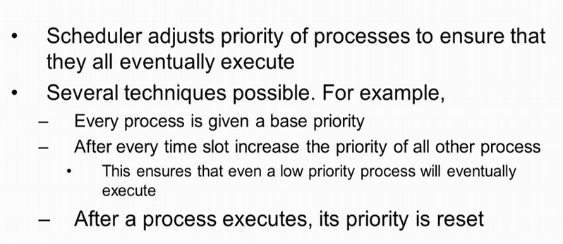
Dealing with starvation (Aging )

Slide 36
Aging
Every time slot or time slice the priority of the process is increased by a fixed value. So, essentially all processes in the ready queue have their priority increased by a fixed value except for the process that is currently being executed in the CPU.
over a period of time all processes in the priority queue would gradually have their priority increased.
Now even a low priority process would have its priority increased up to the point that its priority is high enough so that it is scheduled the CPU.
After it is scheduled into the CPU and executes in the CPU, at the end of its time slice its priority is reset back to its base priority.

Slide 37
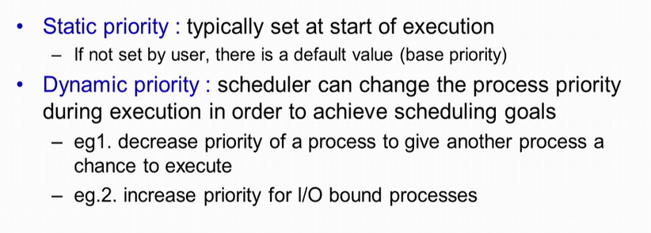
Types of Priority
Static Priority can be set by user who is starting that application, and if the user does not set that particular priority then a default value is taken.

Slide 38
Priority Scheduling advantages and disadvantages
Advantages –
This provides a good mechanism where the relative importance of each process maybe precisely defined.
Disadvantages –
If high priority processes use up a lot of CPU time, lower priority processes may starve and be postponed indefinitely.The situation where a process never gets scheduled to run is called starvation.
Another problem is deciding which process gets which priority level assigned to it.

Slide 39
Round Robin (RR)
Each process gets a small unit of CPU time (time quantum), usually 10-100 milliseconds. After this time has elapsed, the process is preempted and added to the end of the ready queue
If there are n processes in the ready queue and the time quantum is q, then each process gets 1/n of the CPU time in chunks of at most q time units at once. No process waits more than (n-1)q time units
Performance
q large ⇒ FCFS
q small ⇒ q must be large with respect to context switch, otherwise overhead is too high.

Slide 40
Example of RR with Time Quantum = 20
Process Burst Time
P₁ 53
P₂ 17
P₃ 68
P₄ 24
The Gantt chart is: Typically, higher average turnaround than SJF, but better response.
P₁
P₂
P₃
P₄
P₁
P₃
P₄
P₁
P₃
P₃
0
20
37
57
77
97
117
121
134
154
162

Slide 41
Problem
Given below are the arrival and burst times of four processes P1, P2, P3 and P4. Draw the Gantt Chart using RR Scheduling. Calculate the average waiting time, average turn around time and average response time. Assume the time slice is 4ms.

Slide 42
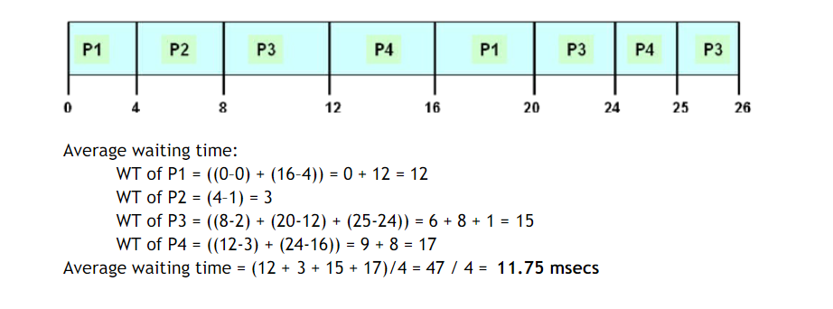
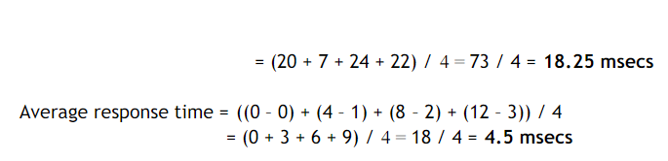

Slide 43
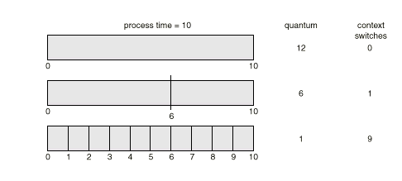
Time Quantum and Context Switch Time

Slide 44
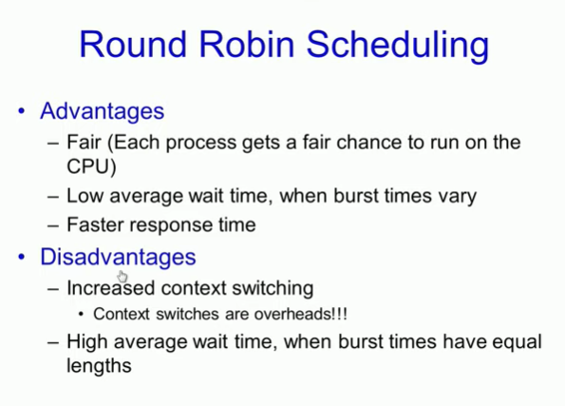

Slide 45
Links
https://www.scribd.com/doc/121618986/Process-Scheduling-problems

Slide 46
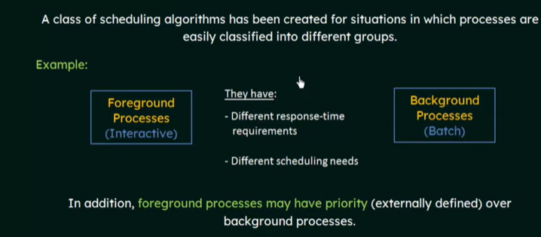
Multilevel Queue Scheduling

Slide 47
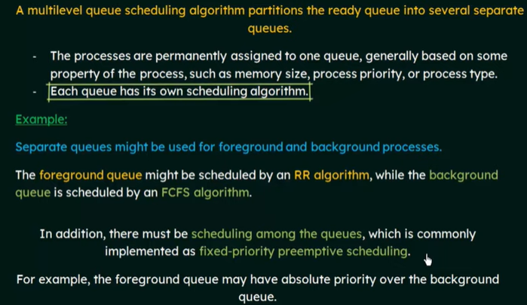

Slide 48
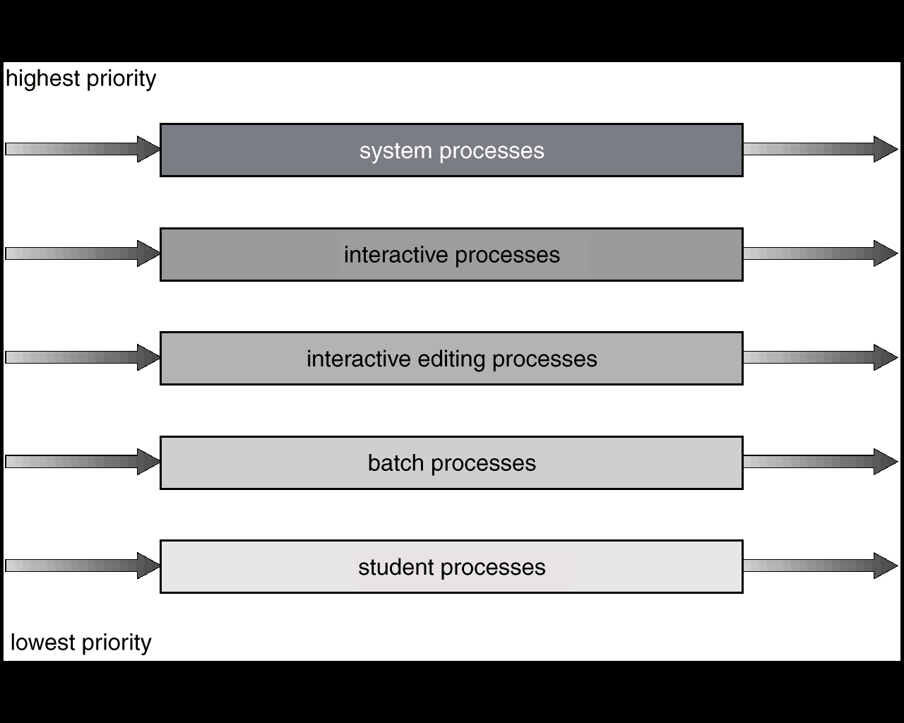
Multilevel Queue Scheduling

Slide 49
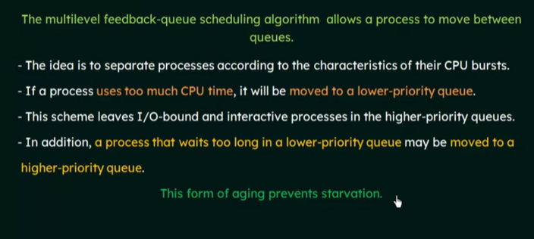
Multilevel Feedback Queue

Slide 50
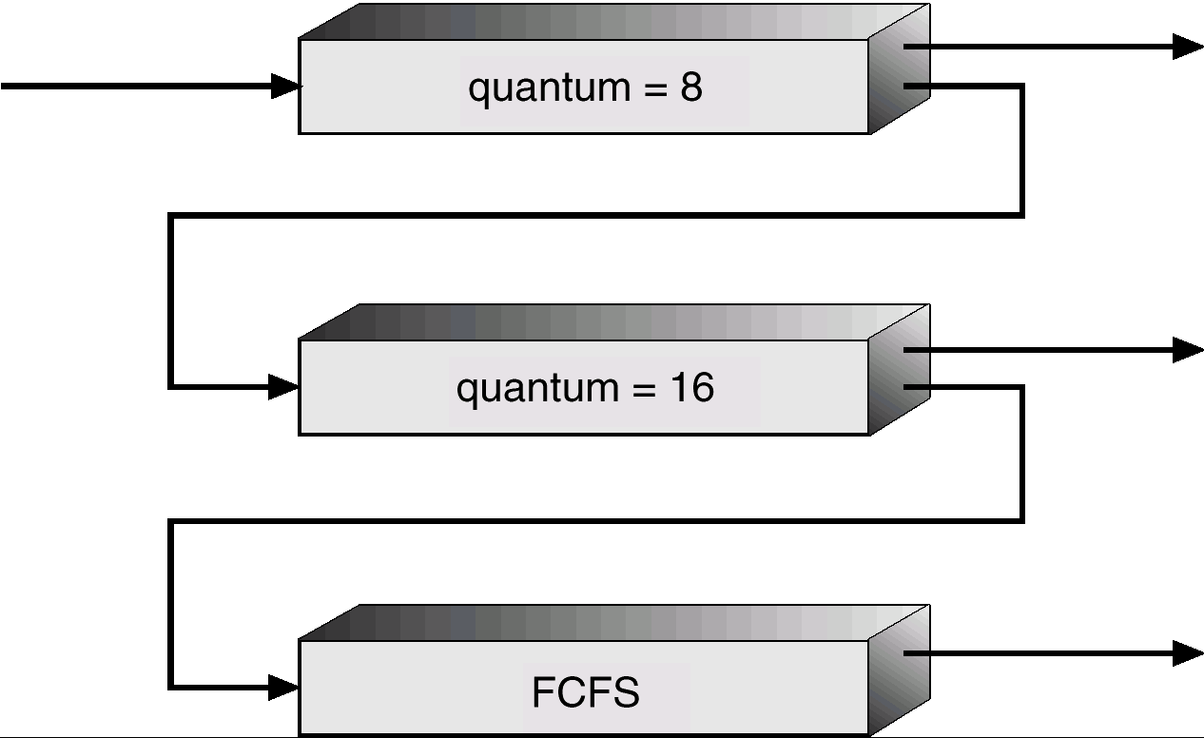
Multilevel Feedback Queues

Slide 51
Example of Multilevel Feedback Queue
Three queues:
Q₀ – time quantum 8 milliseconds
Q₁ – time quantum 16 milliseconds
Q₂ – FCFS
Scheduling:
A new job enters queue Q₀ which is served FCFS. When it gains CPU, job receives 8 milliseconds. If it does not finish in 8 milliseconds, job is moved to queue Q₁.
At Q₁ job is again served FCFS and receives 16 additional milliseconds. If it still does not complete, it is preempted and moved to queue Q₂.
The Multilevel Feedback Queue Scheduling is preemptive.

Slide 52
THANK YOU

